Slide 1
NITRA

Slide 2
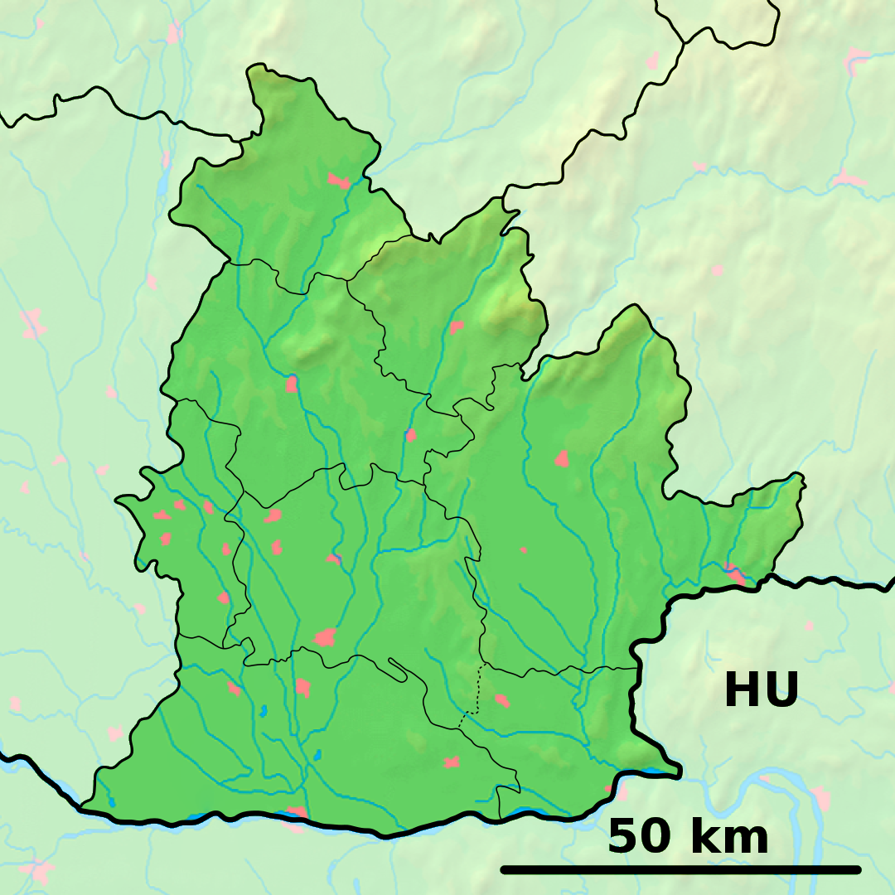
Nitra is a city in western Slovakia, situated at the foot of Zobor Mountain in the valley of the river Nitra. With a population of about 78,353, it is the fifth largest city in Slovakia. Also it´s one of the oldest cities in Slovakia, it was the political center of the Principality of Nitra but today it is a seat of a kraj – Nitra Region and an okres – Nitra District.
Nitra

Slide 3
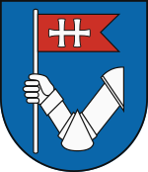
Mayor : Marek Hattas Total Area : 100.48 km2 Elevation : 190 m – 620 ft
Coat of arms :
Flag :

Slide 4
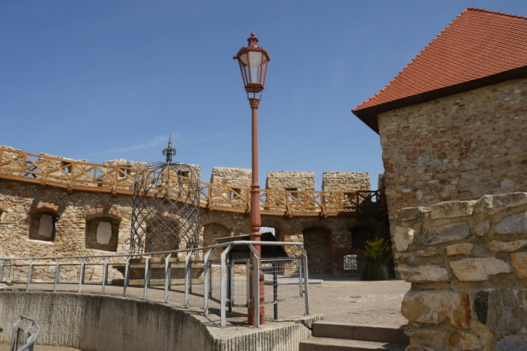
History
After World War I and in the atmosphere of postwar chaos and raising anarchy, the Hungarian National Council in Nitra decided to negotiate with the Czechoslovak Army, pushing out Hungarian military forces and police from the territory of present Slovakia. The Hungarian National Council and the Town Council needed the Czechoslovak Army to restore public order, but hoped that situation was only temporary and formally protested against the "occupation" on 10 December 1918. However, the town became a part of Czechoslovakia. Nitra continued to be the seat of the Nitra county, until it was dissolved in 1928. In 1933, Nitra played an important role
in the Slovak autonomist movement when
the Pribina's Celebration (the anniversary
of the consecration of the first Christian church)
turned to the largest demonstration against
Czechoslovakism.

Slide 5
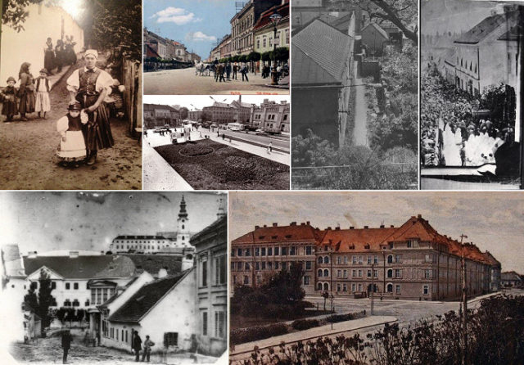
After break-up of Czechoslovakia in 1939, Nitra became a part of the First Slovak Republic and once again a seat of Nitra county until 1945. The period of the First Slovak Republic was tragic for the numerous Jewish population of Nitra, which was first victimized by the anti-Jewish law and then mostly exterminated in German concentration camps (90% of Jewish citizens). The city was liberated by the Soviet Red Army in 1945, for only three years of restored democracy in Czechoslovakia.
Slovak historians believe that Nitra is the location of the oldest Slovakian Jewish community. The Communist period from 1948 to 1989 was marked by the oppression of the Catholic church, which has traditionally had a strong presence in Nitra. Catholic seminaries, monasteries and other properties were nationalized and converted to museums, schools and offices. This period experienced extensive growth, building of housing projects and
annexing of formerly independent villages.

Slide 6
Main sights
- Nitra Castle, Calvary hill, Emmeram´s Cathedral, Drážovce church, Nitra Synagogue,...
NITRA CASTLE
The dominant of the oldest Slovak town Nitra is the Castle of Nitra. It was built in the 11th century on the site of a bulky Slav fort, the seat of the Nitra Princedom and Great Moravian rulers. Today it is the seat of the Bishopric of Nitra.
It was built in the 11th century and consists of several parts. The core of the Castle is the cathedral with the adjacent Bishops residence.
The oldest surviving part of the Cathedral is the Romanesque church of St Emeram from the 11th or 12th century. It was rebuilt after fire in the second half of the 13th century and after Matúš Čáks soldiers destroyed it, a new Gothic church was built next to it in 1317. From then on it served as what is called ”trustworthy” place of chapter and later as the treasury of the cathedral. Today, it forms together with the Upper and Lower Churches the most valuable structure in the area of the Castle - the Bishops Cathedral.
The originally Gothic Upper Church was built in the years 1333-1335 and three centuries later the Lower Church was added to it.

Slide 7
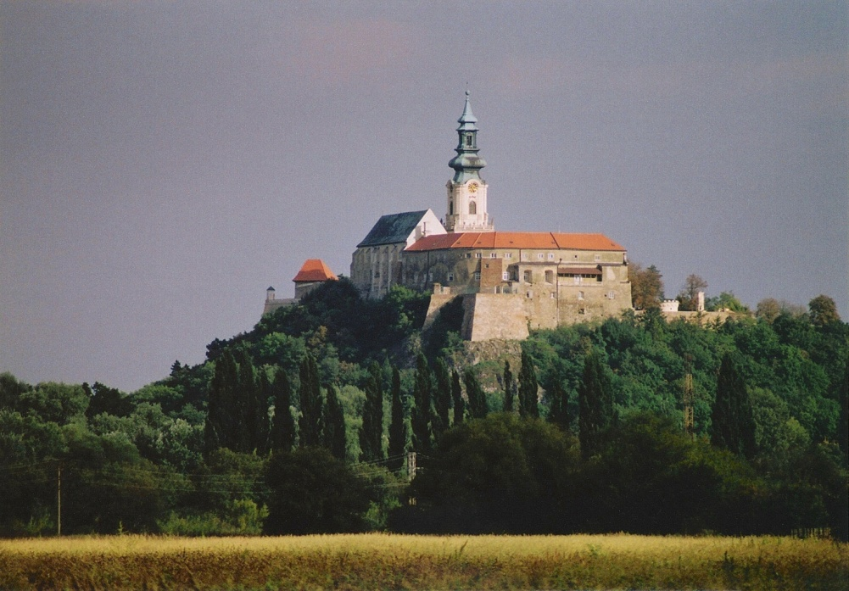
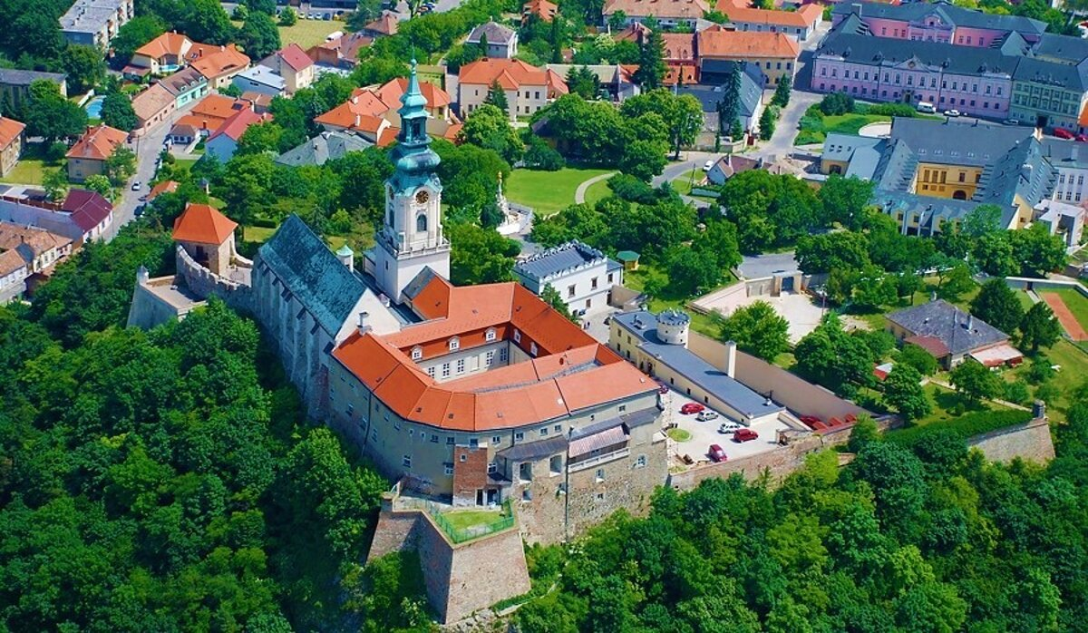
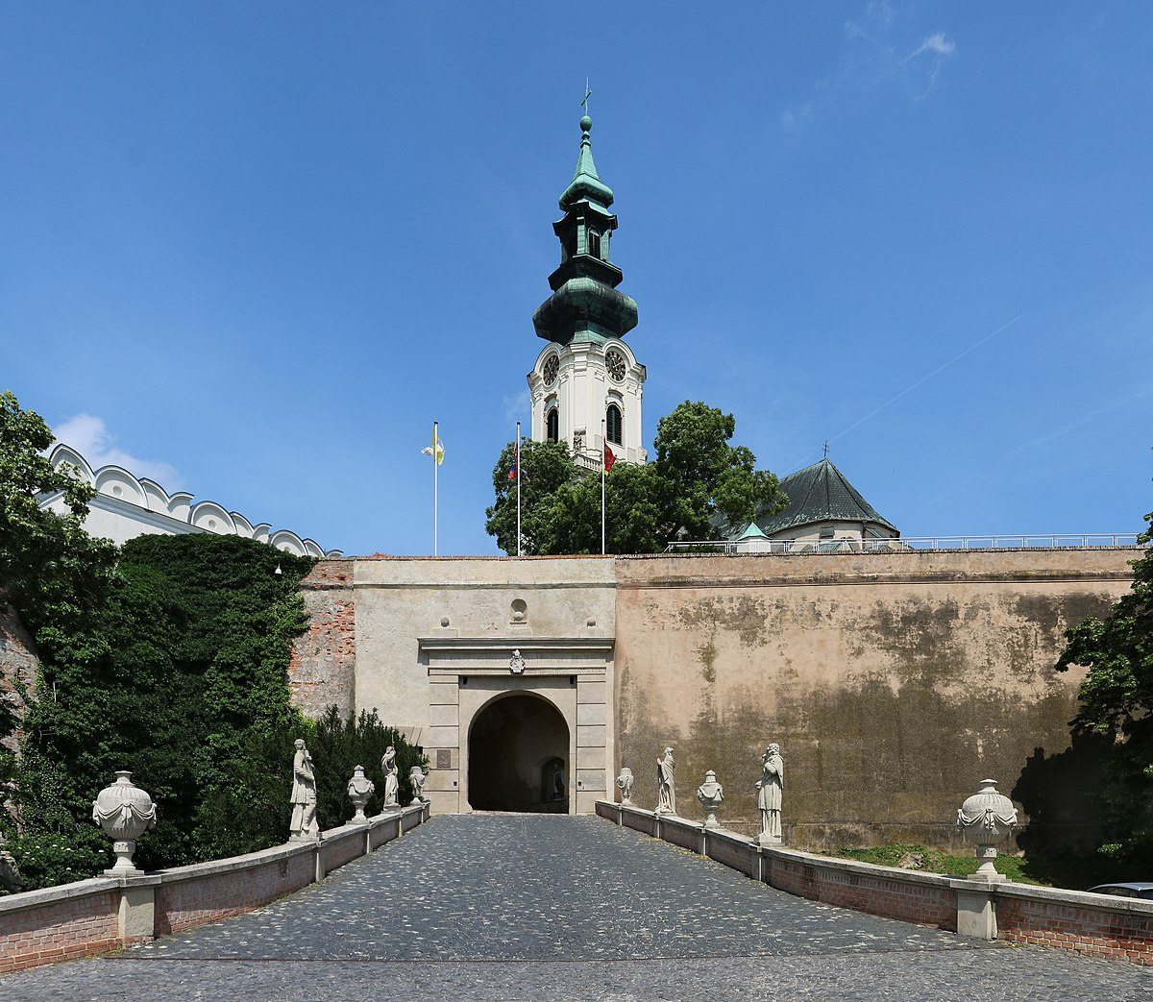

Slide 8
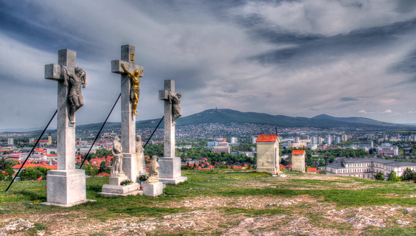
Calvary hill
Was, according to the canonical Gospels, a site immediately outside Jerusalem's walls where Jesus was crucified The canonical Gospels use the Koine term Kraníon (Κρανίον) when testifying to the place outside Jerusalem where Jesus was crucified. Kraníon is often translated as "Skull" in English, but more accurately means Cranium, the part of the skull enclosing the brain. In Latin it is rendered Calvariae Locus, from which the English term Calvary derives.
Its traditional site, identified by Queen Mother Helena, mother of Constantine the Great, in 325, is at the site of the Church
of the Holy Sepulchre. A 19th-century
suggestion places it at the site now
known as The Garden Tomb on Skull
Hill, some 500 m (1,600 ft) to the north,
and 200 m (660 ft) north of the Damascus Gate.

Slide 9
EDUCATION
Nitra is the seat of two universities: University of Constantinus the Philosopher, with 13,684 students, including 446 doctoral students.] and of the Slovak University of Agriculture, with 10,297 students, including 430 doctoral students. The city's system of primary education consists of 14 public schools and three religious primary schools, enrolling in overall 6,945 pupils.] Secondary education is represented by five gymnasia with 3,349 students, 8 specialized high schools with 3,641 students, and 5 vocational schools with 3,054 students.] Schools in the city include the United Catholic School.
Nitra used to be the site of the Jewish school Yeshiva of Nitra, the last surviving yeshiva in occupied Europe during World War II, associated with famous rabbis Chai, Michael Dov, Weissmandil. And Shmuel Dovid Ungar. The yeshiva
was moved to Mount Kisco, New York, USA, after
the second world war, where it still exists.

Slide 10
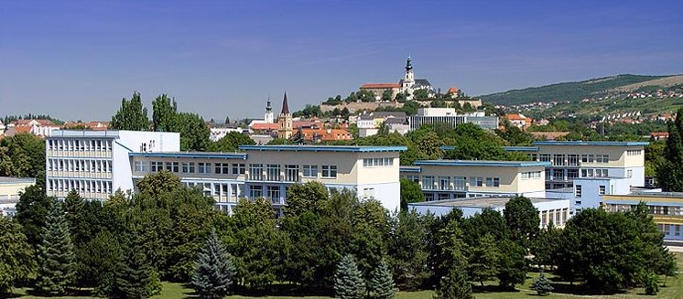
Nitra is the seat of two universities: University of Constantinus the Philosopher, with 13,684 students, including 446 doctoral students. and of the Slovak University of Agriculture, with 10,297 students, including 430 doctoral students. The city's system of primary education consists of 14 public schools and three religious primary schools, enrolling in overall 6,945 pupils. Secondary education is represented by five gymnasia with 3,349 students, 8 specialized high schools with 3,641 students, and 5 vocational schools with 3,054 students.

Slide 11
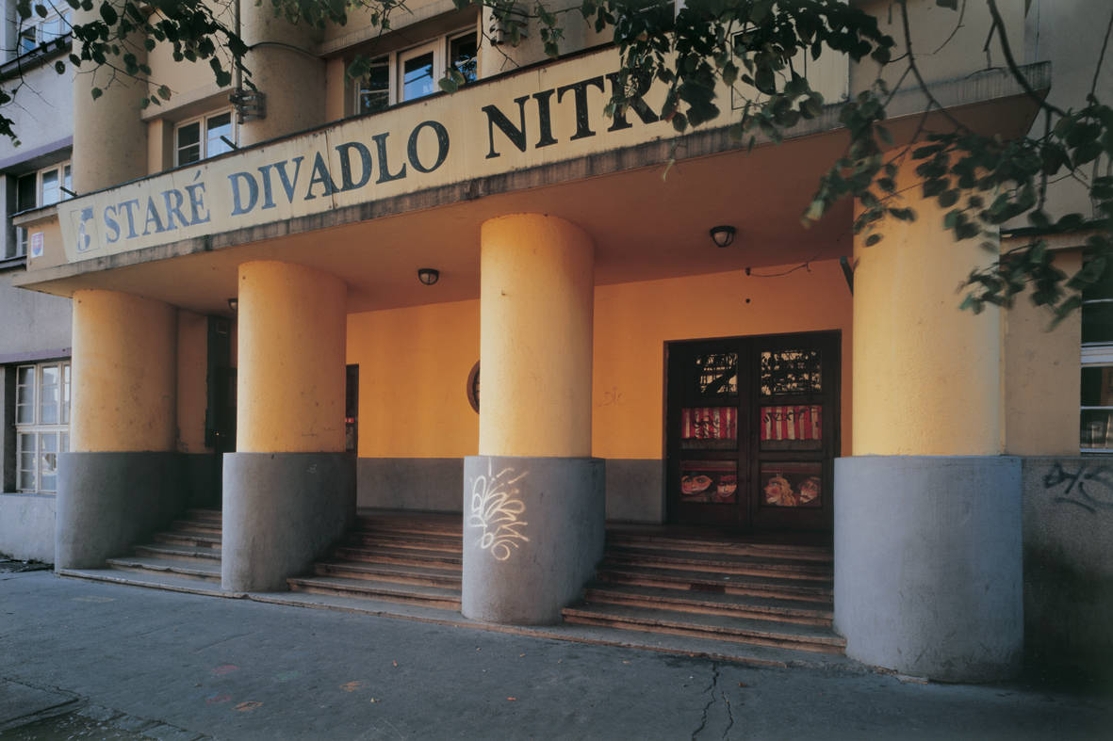
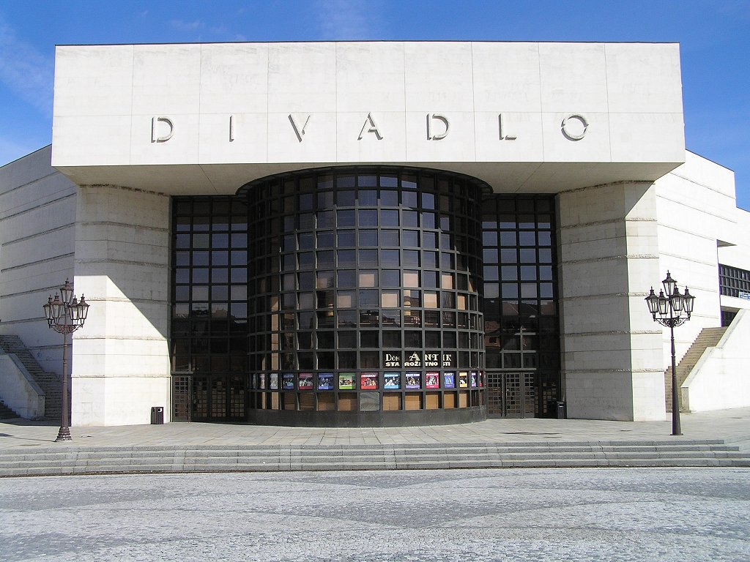
CULTURE
Andrej Bagar Theatre
is a theatre located in Nitra, Slovakia. It opened in 1949. The theatre was known as Nitrianske krajové divadlo (Nitra Region Theatre) and Krajové divadlo Nitra (Regional Theatre Nitra) before being named after actor Andrej Bagar in 1979.
Theatre of Karol Spišák
is a theater in Nitra. Karol Spišák has been working in Nitra since 1949, according to Andrej Bagar he has been called since 1979. Since 1992 he has been performing in one of the largest and most modern theater buildings in Slovakia.

Slide 12
Thanks for paying attention ☺

