Slide 1
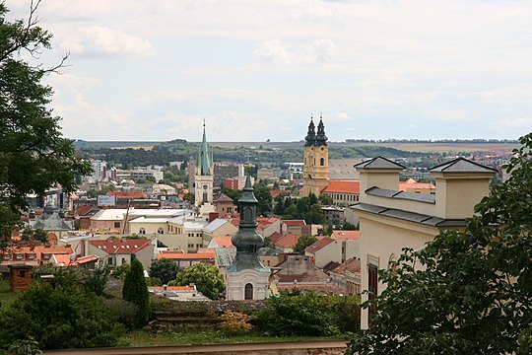
Nitra
Adam Miklovič
7.A

Slide 2
Informations
Nitra is a town located in the Nitra Region, approximately 70 km east of the capital City of Bratislava. It flows through the eponymd river Nitra. The panorama of Nitra consists of Seven Hills: from the north side there is a hill Zobor, Castle Rock, Vŕšok, Calvary, Borina, Ľupka, together with Martinské vrch. The first confirmed historical mentions are from 828. It is named asteroid (9543) Nitra. The population is the sixth largest city in Slovakia.

Slide 3
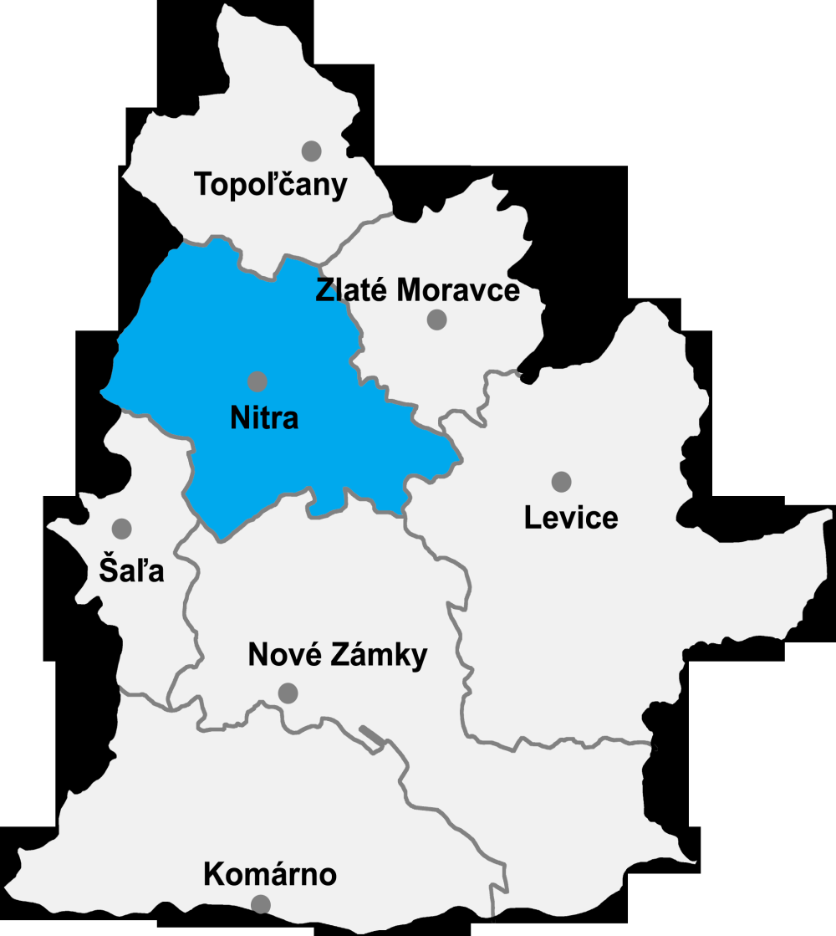
Position
The town is situated in the Danube Uplands, on the River Nitra near the southern edge of the Tribeč Mountains. North of the city, the Zobor hill rises with a transmitter and several viewing terraces.

Slide 4
Position
The city is a long-time crossroads of roads from the west (R1 from Trnava and II/513 from Hlohovec), north (I/64 from Topoľčian and II/593 from Partizánske), east (R1 and I/65 from Zlaté Moraviec and I/51 from Vrábieľ) and south (I/64 from Nové Zámkov and II/562 Railway lines Nové Zámky – Prievidza and Leopoldov – Kozárovce cross near the city. Trnava lies 47 km west, Topoľčany 35 km north, Zlaté Moravce 29 km east and Nové Zámky 37 km south. Bratislava lies 87 km southwest and is connected to Nitra by expressway.

Slide 5
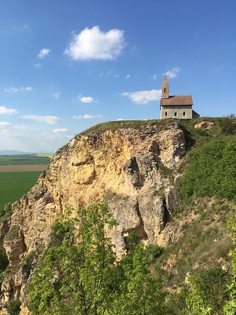
Sights
Nitra Castle dominates the city, as the most famous cultural monument. The castle complex consists of a cathedral, a bishop's palace, fortification walls and farm buildings. Confirmed written reports on the castle date back to 871, and the records in the Maurican Chronicle from the mid-11th century already mention the Basilica of St. Emeram, which still forms part of the castle complex. from the 11th century, rebuilt and modified in the Baroque period in the 15th century. Since 1962, the set of castle buildings has been a national cultural monument.

