Slide 1
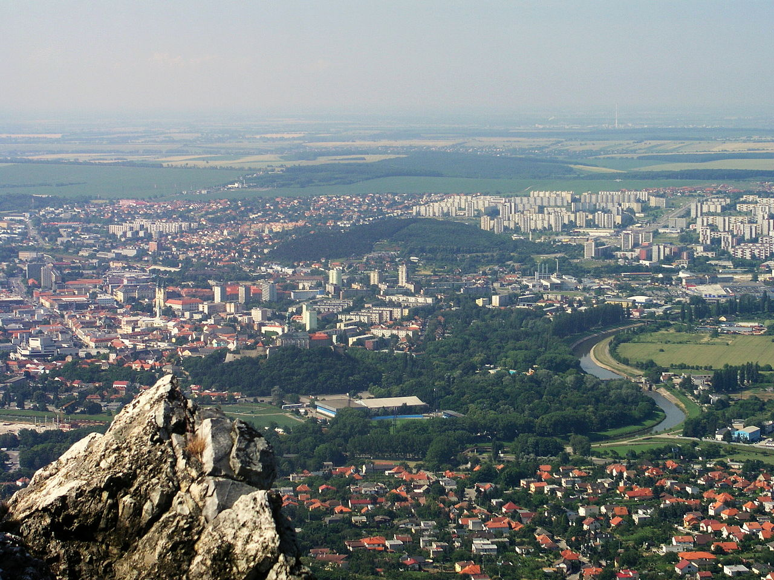
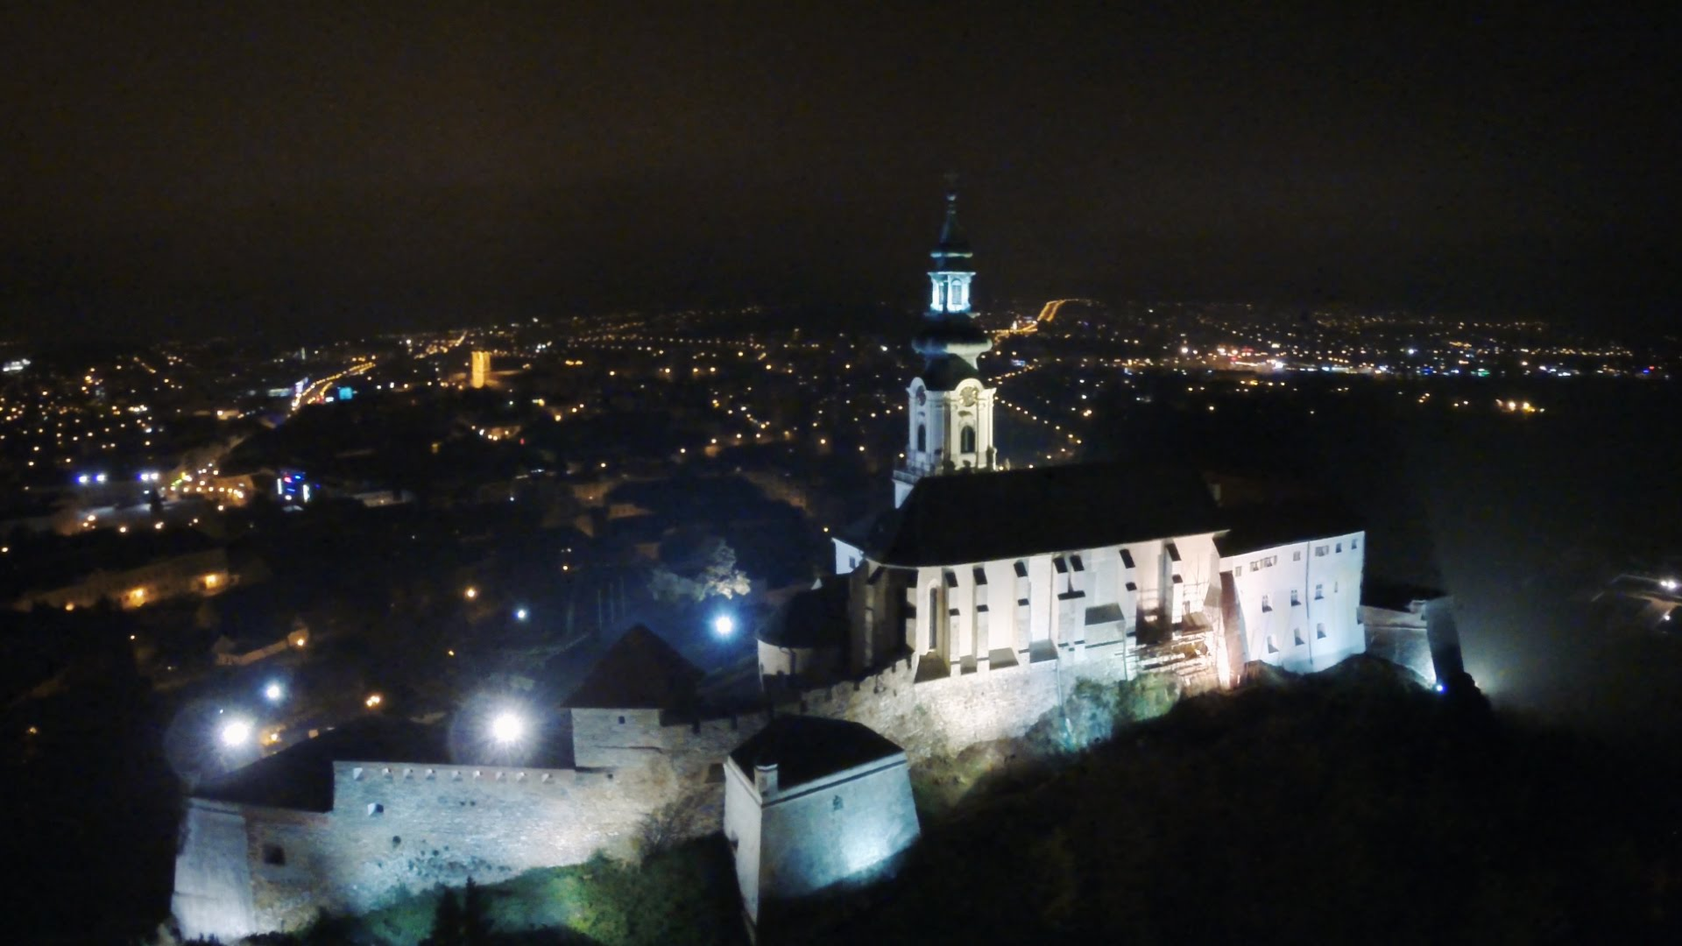
Nitra

Slide 2
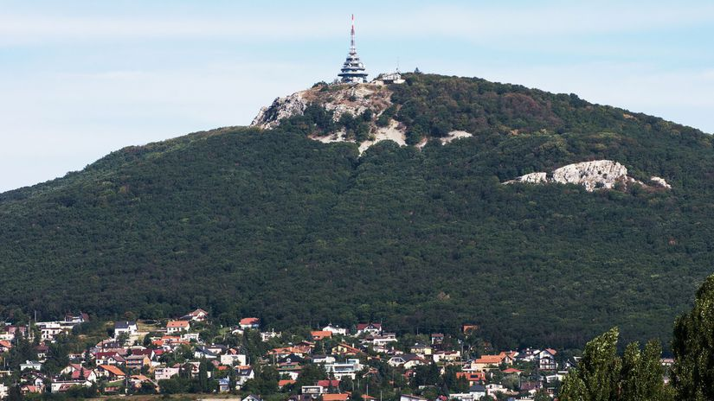
Basic informations
Nitra is a city in western Slovakia, situated at the foot of Zobor Mountain in the valley of the river Nitra. With a population of about 78,353 it is the 5. largest city in Slovakia. Nitra is also one of the oldest cities in Slovakia; it was the political center of the Principality of Nitra. Today, it is a seat of Region Nitra, and also of Nitra District.

Slide 3
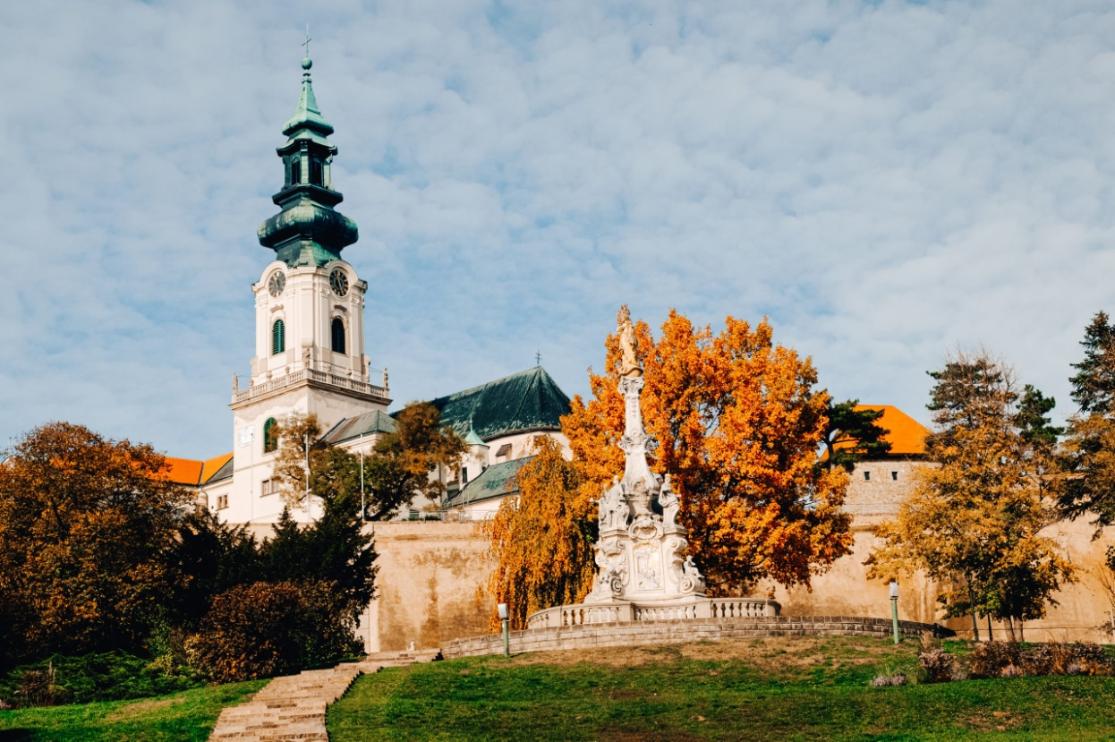
Interesting places
Points of interest in the area include the Nitra Castle, the old town and the hill named Zobor, overlooking the city.
Notable religious structures located in Nitra are St. Emmeram's Cathedral in Nitra castle, a Piarist church of St. Ladislaus and the adjacent monastery. The oldest church of the city is the Saint Stephen church, which was built in the 11th-12th century, although the foundation of the building was constructed in the 9th century. The old town is dominated by the castle, which is one of the most interesting ancient structures in Slovakia. Archeological finding indicate that a large fortified castle had already stood here at the time of Samo's Empire, in the seventh century.

Slide 4
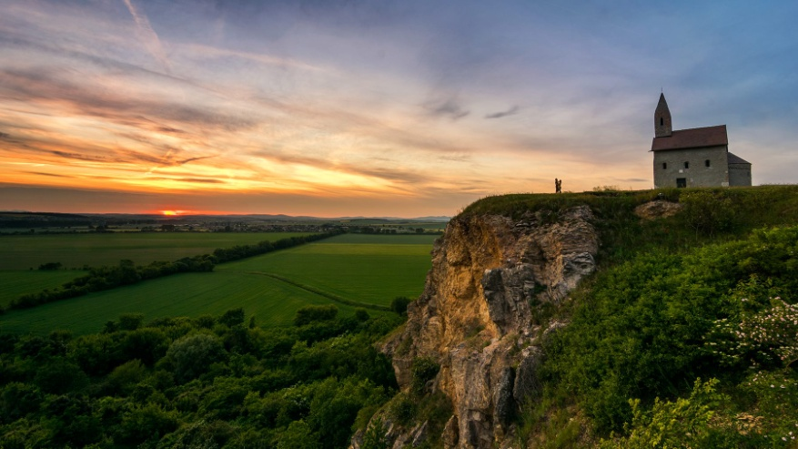
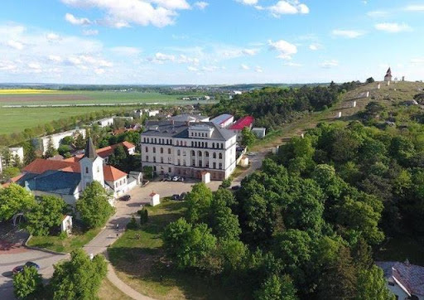
The Dražovce church is a remarkable example of the early Romanesque architecture.
The Virgin Mary's mission house at the Calvary hill was built in 1765 for Spanish order of Nazarens. They were taking care of the church and pilgrims. Later, the building served as an orphanage. In 1878-85 this building was rebuilt in the Novoromanesque style and in 1925 one new floor was added to the building. The building as we know it today is a work of Slovak architect M. M. Harminec. Nowadays the whole building is mission house of The Divine Word Society. The Mission museum of nations and cultures is located in this building.

Slide 5
There are two theaters in Nitra: the Andrej Bagar Theatre and the Old Theatre of Karol Spišák. The Nitra Amphitheater is one of the largest in Slovakia.

Slide 6
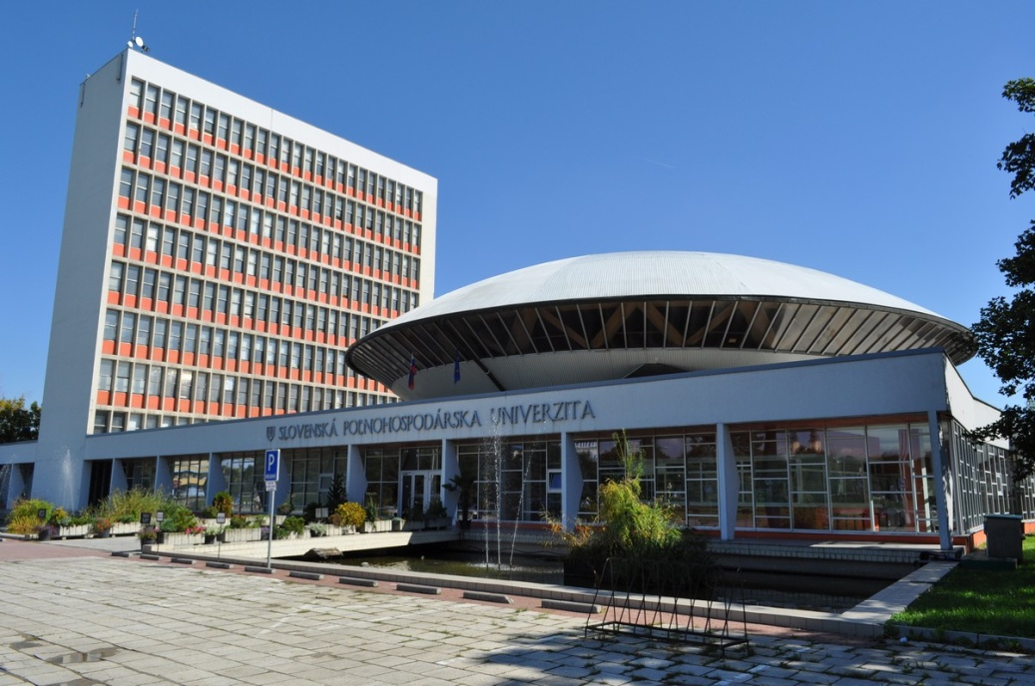
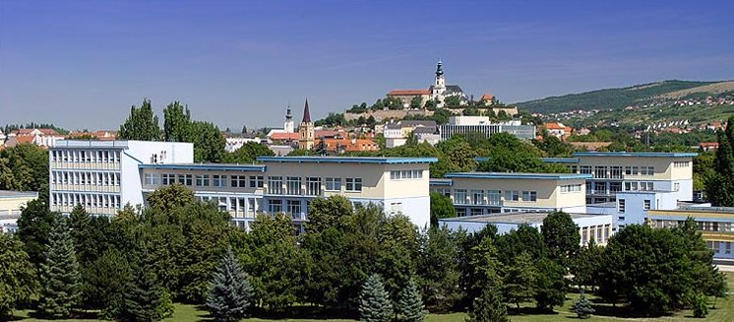
Nitra is the seat of two universities: University of Constantinus the Philosopher, with 13,684 students, including 446 doctoral students and of the Slovak University of Agriculture, with 10,297 students, including 430 doctoral students.
Nitra is the home town of popular Slovak music bands Gladiátor, Horkýže Slíže, Desmod, Zoči Voči and Borra.

