Slide 1
Nitra
Anglický jazyk Lilien Piliarová 7.A

Slide 2
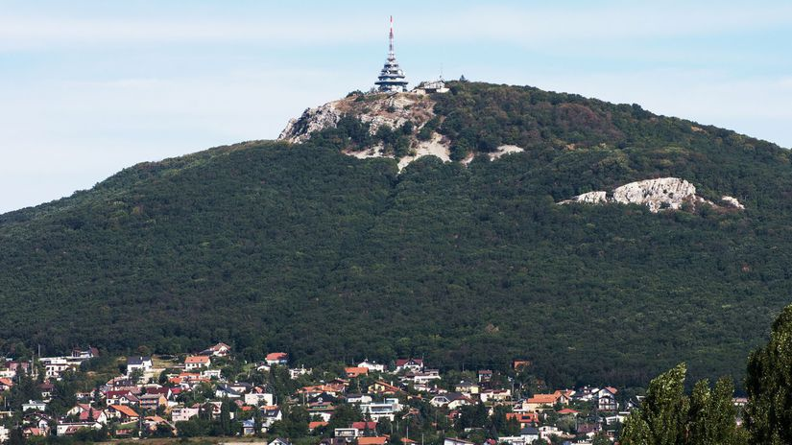
Basic Information
Country: Slovakia
Region: Nitra
Total Area: 100.48 km2
Population: 78,353
Postal code: 949 01

Slide 3
Topography
Nitra lies at an altitude of 190 metres above sea level and covers an area of 100.48 square kilometres. It is located in the Nitra River valley in the Danubian Lowland, where the bigger part of the city is located. A smaller part is located at the southernmost reaches of the Tribeč mountains, more precisely at the foothill of the Zobor mountain 587 metres .It is around halfway between Slovak capital Bratislava, 92 kilometres away and central Slovak city of Banská Bystrica, 118 kilometres away. Other towns in the surroundings include Trnava to the west (53 km), Topoľčany to the north, Levice to the east, and Nové Zámky and Komárno to the south. A national natural reservation called Zoborská lesostep is located within the city's boundaries.

Slide 4
Religion
The religious make-up was 66.1% Roman Catholics and 2.6% Augsburg Confession. Other denominations were declared as less than 0.5%

Slide 5
Schools
University of Constantinus the Philosopher
Slovak University of Agriculture
14 public schools and three religious primary schools
five gymnasia
8 specialized high schools
5 vocational schools
United Catholic School

Slide 6
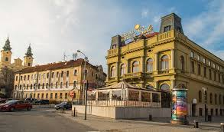
Culture
The Diocesan Museum
Nitra Castle
Mission Museum of Nations and Cultures
Andrej Bagar Theatre
Old Theatre of Karol Spišák
Nitra Amphitheater

Slide 7
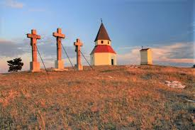
Climate
Nitra lies in the humid continental climate with four distinct seasons. It is characterized by a significant variation between hot summers and cold, snowy winters. The city is located in the warmest and driest part of Slovakia.

Slide 8
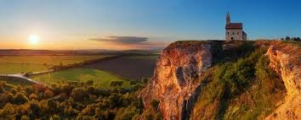
Thanks for attention

