Slide 1
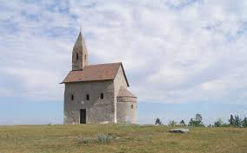
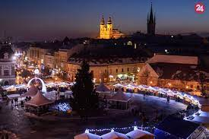
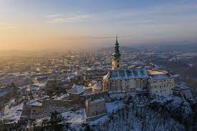
Tomáš Galo 7.A

Slide 2
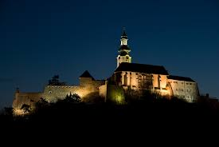
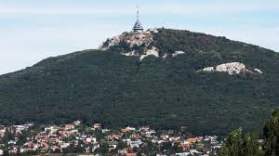
Nitra
Nitra is one of the historic cities. It was a densely populated area. The remains of Hradisko Zobor have been preserved from the period 3000 years ago.
The area of ​​today's Nitra was an important center of the Celts, Germans and Slavs. It was the seat of the first known rulers. Excavations of richly equipped cemeteries date from the 9th century.
In the 9th century, Prince Pribin lived here, the town was one of the centers of Great Moravia. Nitra is a city located in the Nitra region, about 70 km east of the capital Bratislava.

Slide 3
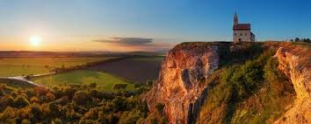
The panorama of Nitra consists of 7 hills: Zobor, Hradná skala, Vŕšok, Kalvária, Borina, Ľupka. It is the sixth largest city in Slovakia in terms of population. There are many kindergartens, high schools and institutes in Nitra.
Nitra (Hungarian: Nyitra, German Neutra) is a city located in the Nitra region, about 70 km east of the capital Bratislava. The Nitra river of the same name flows through it. The panorama of Nitra consists of Seven Hills: from the northern side rises the hill Zobor, Hradná skala, Vŕšok, Kalvária, Borina, Ľupka, together with Martinský vrch. The first confirmed historical mentions are from the year 828. The asteroid (9543) Nitra is named after her. In terms of population, it is the sixth largest city in Slovakia.
Mesto leží v Podunajskej pahorkatine, na rieke Nitra pri južnom okraji pohoria Tribeč. Severne nad mestom sa vypína vrch Zobor s vysielačom a viacerými vyhliadkovými terasami. Mesto je oddávnou križovatkou ciest zo západu (R1 od Trnavy a II/513 od Hlohovca), severu (I/64 od Topoľčian a II/593 z Partizánskeho), východu (R1 a I/65 od Zlatých Moraviec a I/51 od Vrábieľ) a juhu (I/64 od Nových Zámkov a II/562 od Šale). V blízkosti mesta sa križujú železničné trate Nové Zámky – Prievidza a Leopoldov – Kozárovce. Trnava leží 47 km západne, Topoľčany 35 km severne, Zlaté Moravce 29 km východne a Nové Zámky 37 km južne. Bratislava leží 87 km juhozápadne a s Nitrou je prepojená rýchlostnou cestou.

Slide 4
Population 77,603 (2016)
Origin 826
Settlements Jurský dvor, Lukov Dvor, Mikova Ves, Orechov Dvor
Housing estates Parts, Chrenová, Klokočina, Párovce
Watercourses Nitra river Tributaries: Dobrotka, Selenec and Radošinka Shoulder of Malá Nitra

Slide 5
Thanks for watching …

