Slide 1
My own recipe : Pizza
Natália Mačeková

Slide 2
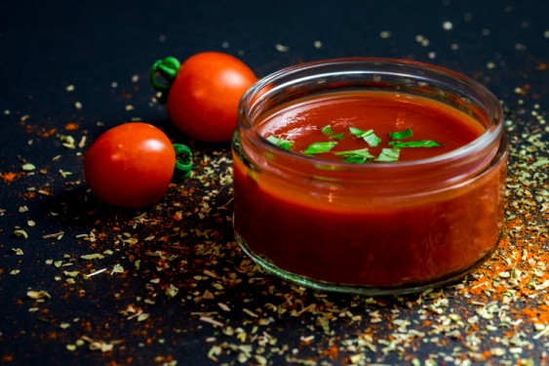
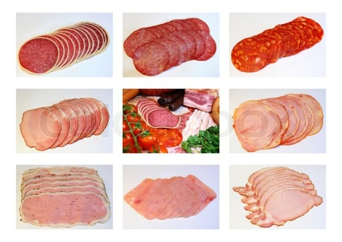
Ingredients
Puff Pastry
Tomato sauce
Ham or salami
Corn,mushrooms or pineapple
Cheese

Slide 3
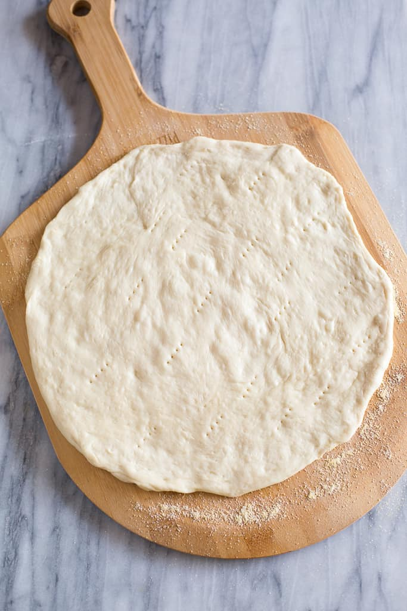
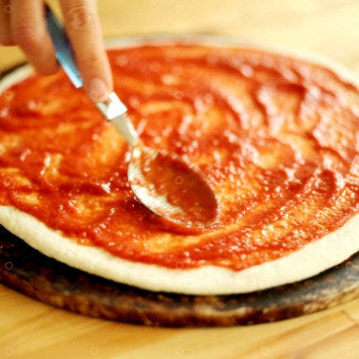
Instructions
Apply tomato puree to the puff pastry.
You can buy it, for example, in Kaufland or Lidl. Then we put ham or salami there, of your choice.
Then cheese and if you want you can use pineapple, corn or mushrooms to flavor.

Slide 4
-Bake for 20-25 minutes at 200 degrees.
It's a very simple recipe and anyone can do it.

